Slide 1


HarbourVest
Presentation
December 2025
Final Presentation
By: Catalina, Sreya, Vineet, Leo, and Eric

Slide 2

Company Access
Company: HarbourVest
Location: Boston, Massachusetts
Contact info: hvpe@harbourvest.com
Senior Vice President: Analia Graham
Contact info: Agraham@harbourvest.com
Junior Level Position: Suiada
Contact Info:Suaidaf@gmail.com.
Notes:
The HarbourVest that we are specifically analyzing for this project is located in Boston, Massachusetts. We were able to get a Senior Vice President, Analia Graham. Analia assists the Head of the Vanguard account in overseeing key strategic initiatives, works closely with HarbourVest portfolio managers to advance core fund activities, and partners with operations and technology teams to develop scalable solutions that support ongoing growth. The second interview took place for a junior-level position. Her name is Suaida, and her email address is Suaidaf@gmail.com.

Slide 3
Background Info & Secondary Data
HarbourVest Partners is a global private market investment firm that is known for providing institutional and private clients across the globe with private equity, fund of funds, secondary fund interests, direct co-investments, real assets, and private credit. HarbourVest is known for its global reach, diversified private market, investment strategies, and long-term experience. Through its “interwoven platform,” it enables investors to access private market opportunities.
Main competitors: Hamilton Lane & Pantheon top global private equity fund-of-funds players in the same domain.
Gender distribution: 37% women, 63% men & representation of women is lower in senior leadership roles. Race and ethnicity: 69% White, 12% Asian, 11% Hispanic/Latino, with the remaining ~8% identifying with other backgrounds.
Racial/ethnic diversity is stronger at entry and mid-levels but very limited in top leadership.
Global Operations & Collaboration Challenges: HarbourVest operates across many regions and time zones in various continents. Teams face challenges in communications, building relationships, and quick feedback as people are working together remotely over 8-12 hour times gaps.
Fragmented Data & Technology Integration Issues: HarbourVest’s quick expansion and its dependence on outsourced data administration creates problems as there many incompatible data systems which only delays sharing crucial information and making fast important decisions during economic volatile periods.

Slide 4


Data Collection Methods
Weeks 4–5
Interviews
Interviews with HarbourVest employees (Analia Graham & Suaida) about communication and output challenges.
Contact HarbourVest reps and send interview questions on communication and collaboration.
Weeks 5–8:
Start secondary research on private markets; hold first interview with Analia and analyze feedback on time zones, remote tools, and global expansion.
Secondary Data Research
Research on HarbourVest and similar private-market firms to compare communication issues and best practices.
Week
9
Conduct second interview with a junior employee in Saudi to compare perspectives on communication and productivity.
Weeks
10-13
Combine interview and research findings, link them to emotional intelligence & organizational justice, and draft recommendations to improve cross-regional collaboration.
Notes:
For our data collectin methods we use mainly two forms of data: interviews and secondary research.
We schedule the interviews during week 5 and 9 for Senior Vice President Analia during Junior Level Position: Suiada
And we did our own research more about harbourvest online and we also research similar private market firms
In Weeks 4–5, we contacted HarbourVest employees and sent interview questions about cross-office communication. While waiting for responses, we began researching the private equity industry to understand how global investment firms manage communication across time zones.
In Week 6, we interviewed Senior Vice President Analia Graham, who explained how global expansion, time differences, and remote tools slow decision-making. Weeks 6–8 were spent continuing secondary research based on her insights.
In Week 9, we interviewed a junior employee in Saudi Arabia, which helped us compare how communication challenges affect different job levels. These differences showed how unclear information impacts both speed and productivity.
From Weeks 10–13, we combined interview insights with our research and connected them to emotional intelligence and organizational justice. This helped explain how unclear communication leads to frustration, misalignment, and inefficiencies, and guided our recommendations to improve collaboration across HarbourVest’s global offices.

Slide 5

Output Problem
Output Problem: Global Communication Challenges
Difficult to schedule Zoom calls across global time zones
Slow responses and fragmented communication delay multi-regional work
Miscommunication leads to confusion, missed deadlines, and rework
Lack of informal interaction weakens relationships and teamwork
Remote reliance causes poor cross-office alignment and employee frustration
Management Perspective
Hard to coordinate meetings and decisions across time zones
Cultural differences & mixed communication styles cause misunderstandings
Asynchronous messaging delays decisions and project progress
Difficult to ensure every office receives information at the same time
Employee Perspective
Unclear roles and priorities between offices
Frustration from vague instructions and slow responses
Feeling excluded from important decisions or updates
Miscommunication leads to errors and duplicated work
Notes:
Our data showed that one of HarbourVest’s output problem was the communication across each global offices. As harbourvest has over 200 different location world wide. This cause a challenge because of the different time zones which causes scheduling difficult, delays, repeating of information, and slower collaboration. Because most interactions happen remotely, tere is less informal conversation, which increases misunderstandings and weakens team relationships.
From a management view, scheduling decisions and meeting across regions is hard. The Cultural differences in communication can lead to misunderstanding. Leaders often rely on asynchronous communication which causes even more delay.
And Employees feel these issues personally. Many are unclear about priorities, confused about responsibilities in other regions, and frustrated by delays in work. Some even feel excluded from important decisions, leading to repeated work and avoidable mistakes.
Overall, these problems create misalignment, frustration, and inefficiencies for both leaders and employees, making global collaboration more difficult.

Slide 6
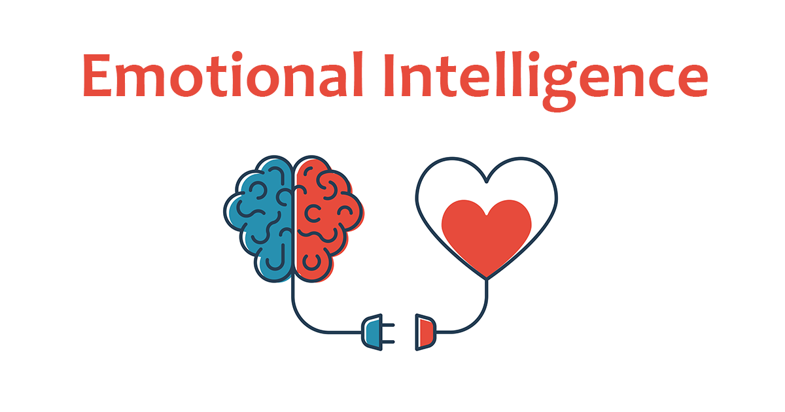
Concept 1- Emotional Intelligence
Benefits:
More empathy with cultural difference and across regions.
Clearer communication and less misunderstandings
Increased self-regulation, helping with managing stress
Allows for building trust and cohesion and increased productivity & team chemistry
Better leadership development and more effective decision making.
Definition: EI is the ability to understand, identify, and manage one’s emotions while responding effectively to the emotions of others. EI allows individuals to have clear communication, strong relationships, and manage conflict effectively within teams.
Relation to Output Problem: EI allows employees and upper management to stay composed during issues like delayed responses, time-zone misalignment, and incompatible data systems. Great EI allows for workforces to stay patient and able to collaborate and focus on solutions effectively during times of issue.

Slide 7

Supporting Evidence
Interview - Analia Graham:
Analia Graham, the Senior VP explained recurring delays and frustration caused by a very small scheduling window across global offices. In these situations, EI let leaders and employees control emotions, manage tones of communication, and keep cohesion, even when contact is slow.
Interview - Suaida Firzone:
Suaida Firzone who is in a junior level talks about how large scaling of HarbourVest has created systems that are incompatible with each other and daily frustrations, which affects productivity and output. EI becomes vital for understanding colleagues handling the same obstacles and strengthening relationships that are building despite little in-person connection.

Slide 8

Supporting Evidence
Emotional Regulation During Uncertainty:
Global tariffs or investment uncertainty often require rapid company decisions, but EI helps mitigate reactions based on emotion, which allows employees to stay level headed and focused on solution. Strong EI helps reduce productivity loss created by frustration with incapable systems, delays, and little of face-to-face interactions. Employees who have high EI can help consistent motivation and engagement, even through inefficiencies and uncertainty.
Cross-Cultural Understanding:
With HarbourVest global employees collaborating from the UK, India, Hong Kong, and Abu Dhabi, EI helps workers to understand cultural norms, communication styles, and contrasting workflows, which minimizes misunderstandings and improving clear clarity of expectations within teams.
Building a Sustainable EI Strategy:
Developing in-depth EI training can support communication improvement long term, improve morale of employees, and create a company culture where teams empathize, clarify, and adapt, instead of reacting emotionally to these internal challenges.

Slide 9
Concept 2 - Organizational Justice
Benefits:
Higher Trust in Leadership: When decisions feel fair and transparent, employees are more likely to trust managers and organizational direction.
Better Collaboration/Teamwork: Fair processes reduce confusion and resentment, making teams more willing to share information and work together effectively.
Increased Motivation/Engagement: Employees who feel respected and fairly treated put in more effort and show stronger commitment to their work.
Reduced Conflict: Employees are less likely to leave or escalate problems when they believe the workplace is equitable.
Definition: Organizational justice refers to employees’ perceptions that decisions, communication, and processes within a company are fair, transparent, and consistent.
Relation to Output Problem: Disparity in the way information is communicated among employees creates a lack of trust and decreases coordination among people working at HarbourVest. These discrepancies create delays in productivity, confusion within global teams, and inefficient methods of collaboration.
Notes:
Organizational justice refers to employees’ perceptions that decisions, communication, and processes within a company are fair, transparent, and consistent. When employees are able to understand why a decision is made, and how responsibilities are administered, they have a better chance of trusting leadership and collaborating with coworkers in an efficient and effective manner.
1. Distributive Justice: Whether outcomes are fair — pay, promotions, workload, recognition.
2. Procedural Justice: Whether the processes used to make decisions are fair — consistent, unbiased, transparent.
3. Interactional Justice: Whether people are treated with respect, given honest explanations, and communicated with fairly.

Slide 10
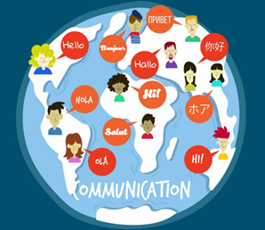
Analysis of Concept 2
Organizational justice helps explain why HarbourVest’s communication and productivity issues persist despite strong leadership.
Fragmented data systems and unclear explanations for strategic or AI-related decisions reduce employees’ sense of fairness and transparency.
The gap between leadership intent and employee perception reveals breakdowns in procedural and informational justice.
These fairness issues slow collaboration, weaken trust, and directly contribute to the output problem of delayed communication and reduced productivity.
Notes:
For instance the firms “fragmented data systems” reflect an organizational justice issue. This issue makes access to accurate and efficient information uneven across teams, what we derive from this is that during periods of tariff, financial volatility, when timely data is crucial, the differences in system functionality can feel unfair and reduce trust in the decision-making process. Additionally employees perceive uncertainty around the implementation of Artificial Intelligence tools. While leadership has to prioritize strategic objectives, staff may feel that the changing decisions about workload, technology, and system upgrades are not communicated transparently, aligning with research showing that inconsistent or unclear communication can undermine perceptions of fairness, even in an environment that does not lack motivation, as Suaida describes.

Slide 11

Supporting Evidence
Interview with Suida Firzone: Our interviews showed several areas within HarbourVest where perceptions of fairness and company transparency are challenged. For instance the firms “fragmented data systems” as Suaida explained, reflect an organizational justice issue. She mentioned that “systems are not compatible with older data tools” when speaking on some struggles that she faces in her role.
Using both the interviews with Analia and Suida, has shown us the disparities in what is intended to be communicated, and what is actually perceived.
Notes:
For instance the firms “fragmented data systems” as Suaida explained, reflect an organizational justice issue. She mentioned that “systems are not compatible with older data tools” when speaking on some struggles that she faces in her role. Our privilege of being able to interview a high ranking executive in Analia, and a young junior employee like Suaida has shown us the disparities in what is intended to be communicated, and what is actually perceived. Further showing us how crucial the skill of organizational justice can really be, how it is truly important for all members of a company to have a deep understanding of choices made, how information is shared, and how responsibilities are distributed. As HarbourVest navigates AI integration and rapid global expansion, transparent decision-making becomes essential. Without clear explanations of priorities, trade-offs, or system changes, employees may feel uncertain about the fairness of resource allocation or strategic choices, which contributes to delays, confusion, and fragmented workflows.

Slide 12
Recommendation #1: Incorporating EI
HarbourVest should implement Emotional Intelligence (EI)-based leadership practices across all offices to improve communication and collaboration in its globally distributed teams. This includes:
EI Training for Managers: Provide structured training focused on empathy, active listening, cultural awareness, and emotion-aware communication to help leaders better understand and respond to employees’ needs.
Regular Team Check-Ins: Conduct monthly or quarterly check-ins with teams across all offices. These check-ins should cover not only project updates but also employee well-being, clarification of expectations, and feedback on cross-office communication challenges.
Application in Virtual Settings: Encourage leaders to apply EI skills in Zoom or other virtual meetings by actively soliciting input, noticing non-verbal cues, and fostering open dialogue among geographically dispersed teams.
Notes:
HarbourVest faces communication challenges due to globally distributed teams working across different time zones and cultures. Over-reliance on virtual tools like Zoom creates scheduling delays, misunderstandings, and disruptions in workflow coordination.
To address this, we recommend implementing emotional intelligence (EI)–based leadership and communication training across all offices. Training would focus on empathy, active listening, cultural awareness, and clear communication. In addition, we propose regular “clarity check-ins” for global project teams to surface concerns early, strengthen collaboration, and prevent conflicts or inefficiencies.
Strengthening EI skills will help reduce miscommunication, disengagement, and cultural friction while building a more supportive and high-performing work environment. Major companies like Microsoft and Google have adopted similar approaches to improve teamwork and retention.

Slide 13
Best Practices and Potential Downfalls rec 1
Best Practices:
Microsoft – Global Product Team Check-Ins
Microsoft’s distributed teams hold regular cross-office check-ins to clarify project goals, deadlines, and concerns.
Managers are trained to actively listen, acknowledge feedback, and address miscommunication quickly.
Outcome: improves cohesion, reduces errors, and strengthens collaboration among geographically dispersed teams.
Potential Downfalls:
May Not Work for Everyone
Some managers or employees may resist EI training or perceive check-ins as “non-essential,” reducing participation or engagement.
Time and Resource Costs
Monthly or quarterly check-ins require time away from revenue-generating or core work. Training programs for EI also require investment in resources and planning.
Unintended Consequences
Overemphasis on emotional check-ins could slow decision-making or reduce accountability if not balanced with performance expectations.
Poorly executed check-ins may feel like “lip service,” which can decrease trust rather than increase it.
Notes:
Of course, there are potential downsides, just like any other recommendation. Some leaders or staff may view emotional intelligence training as “non-essential” or too “soft”, leading to a limited buy-in from employees. The time required for training and check ins, may also reduce time spent on billable or revenue generating work. There is also a risk that emphasizing emotional well being too heavily could soften accountability or slow decision making, especially in a fast paced investment environment like private markets.
Google defines emotional intelligence (EI) as understanding and managing your own and others' emotions, crucial for leadership, teamwork, and navigating work, famously developing the "Search Inside Yourself" (SIY) program based on mindfulness and neuroscience to build skills like self-awareness, self-regulation, empathy, and motivation

Slide 14

Recommendation #2
Create a unified, leadership-run data and decision portal accessible to all HarbourVest offices.
Provides real-time updates on major decisions, priorities, resource allocations, and tech rollouts.
Includes a “Why This Decision Was Made” section to clarify executive reasoning.
Adds an anonymous employee feedback tool to increase voice and psychological safety.
Reduces confusion and improves fairness by giving every region equal access to information.

Slide 15

Best Practices and Potential Downfalls: Rec 2
Best Practice Examples:
Deloitte Knowledge Platform: Unified portal improved coordination across dozens of global offices.
JPMorgan Change-Communication Memos: Internal summaries used to explain workflow or technology updates.
Potential Downfalls:
Some managers/employees may resist system changes or prefer siloed workflows.
Requires financial investment: new software, IT integration, and company-wide training.
Greater transparency may expose workload imbalances or performance disparities, creating tension.

Slide 16


Communication strategies and influencing tactics
Communication Strategies & Influencing Tactics
Social Proof: Highlight Deloitte’s success to show the system is industry-standard and effective.
Give and Take: Present the system as a benefit — clearer decisions, more transparency, less confusion.
Emphasize improvements in fairness, trust, and cross-office alignment.
Reassure employees with anonymous feedback features that enhance voice and psychological safety.

Slide 17
Work Cited
Becker & Behme. “The New Knowledge Management.” Deloitte Insights, Deloitte, 27 Jan. 2021.
“The Benefits of Knowledge Management in Organizations.” ResearchGate.
“Home - HarbourVest.” HarbourVest, 29 Oct. 2025, www.harbourvest.com. Accessed 4 Dec. 2025.
II, Julian Hayes. “JPMorgan’s Internal Memo Highlights 2 Missed Signals in RTO Mandates.” Forbes, 11 June 2025.
Kruse, Kevin. “How Google Builds Emotionally Intelligent Leaders in AI Era.” Forbes, 18 Nov. 2025.
Maldonado, Isabel Coronado, and María-Dolores Benítez Márquez. “Emotional Intelligence, Leadership, and Work Teams: A Hybrid Literature Review.” Heliyon, vol. 9, no. 10, 2023, pp. 1–19, pmc.ncbi.nlm.nih.gov/articles/PMC10543214/.
Mayer, John D., and Peter Salovey. “What Is Emotional Intelligence?” ResearchGate, Jan. 1997.
Mayer, John D., et al. “Emotional Intelligence: New Ability or Eclectic Traits?” American Psychologist, vol. 63, no. 6, Sept. 2008, pp. 503–517.
Myers, Tara, and Megan Paul. “Organizational Justice.” DigitalCommons@University of Nebraska – Lincoln, 2020.

Slide 18

Thank you for your time!

